Slide 1
Chapter 5
The LC-3 Instruction Set Architecture
ISA Overview
Operate instructions
Data Movement instructions
Control Instructions
LC-3 data path

Slide 2
LC-3 ISA Overview
Memory organization
  Address space: 216 = 64k locations
  Addressability: Word (= 2 bytes)
    => total memory = 64k x 2 = 128 kbytes
Registers
  8 x 16 bit General Purpose Registers: R0 - R7
  3 x 1 bit Condition Code Registers: N, Z, P
Instructions
  16 bit instructions, with 4 bit opcodes
  Native Data Type: only 2’s complement integer
  Addressing Modes:
    Immediate, Register (non-memory addressing modes)
    Direct, Indirect & Base+Offset (memory addressing modes)

Slide 3
LC-3 Instructions
Operate
  Manipulate data directly
    ADD, AND, NOT
Data Movement
  Move data between memory and registers
    LD, LDI, LDR, LEA, ST, STI, STR
Control
  Change the sequence of instruction execution
    BR, JMP/RET, JSR/JSSR, TRAP, RTI

Slide 4
Instruction Construction
Two main parts
  Opcode: specifies what the instruction does.
  Operand(s): what the instruction acts on.
  Instruction sets can be complex or simple (CISC, RISC), single-word or multi-word.
LC-3
  Single word (16 bit) instructions.
  4-bit opcode => 16 instructions (very simple set!)
  remaining 12 bits specify operand(s), according to the addressing mode proper to each instruction.

Slide 5
LC 3 Instructions
LC-3 Instruction word: 16 bits
  Opcode
    IR[15:12]: 4 bits allow 16 instructions
    specifies the instruction to be executed
  Operands
    IR[11:0]: contains specifications for:
    Registers: 8 GPRs (i.e. require 3 bits for addressing)
    Address Generation bits: Offset (11 or 9 or 6 bits) (more later)
    Immediate value: 5 bits
Examples
  ADD DR, SR1, SR2 ; DR ← (SR1) + (SR2)
  [15:12] [11:9] [8:6] [2:0]
  LDR DR, BaseR, Offset ; DR ← Mem[BaseR + Offset]
  [15:12] [11:9] [8:6] [5:0]

Slide 6
Addressing Modes
      Note: the effective address (ea) is the memory location of the operand
The LC-3 supports five addressing modes:
  the operand is located:
    in the instruction itself (immediate)
    in a register
    in memory:
      the ea is encoded in the instruction (direct, or PC-relative)
      a pointer to the ea is encoded in the instruction (indirect)
      a pointer to the ea is stored in a register (relative, or base+offset)

Slide 7
Operate Instructions - 1
Arithmetic and Logic
  Arithmetic: add, subtract, multiply, divide (the LC-3 only has add)
  Logic: and, or, not, xor (the LC-3 only has and, not)
LC-3: NOT, ADD, AND
    AND (opcode = 0101) has the same structure as ADD
dest reg
src reg
1 0 0 1
0 1 1
0 1 0
1
1 1
1 1 1
NOT
R3
R2
dest reg
src reg
src reg
0 0 0 1
0 1 1
0 1 0
0
0 0
1 0 1
ADD
R3
R2
R5

Slide 8
Operate Instructions - 2
NOT (unary operator)
  destination register in IR[11:9] and a single source register in IR[8:6].
  bits IR[5:0] are all 1s.
ADD & AND (binary operators)
  destination register in IR[11:9], one source register in IR[8:6]
  other source:
    immediate addressing mode:
      if bit IR[5] = 1, bits IR[4:0] specify the other source number directly, as
      a 5 bit 2’s complement integer, which is sign extended (SEXT) to 16 bits.
    register addressing mode:
      if bit IR[5] = 0, bits IR[2:0] specify a register for the second source
      bits IR[4:3] = 0

Slide 9
Immediate & Register Operands
Immediate
  If bit 5 = 1, the value in IR[4:0] (“immediate”) is sign extended (SEXT) to
  16 bits and added to the contents of the source register SR1 (IR[8:6]).
Register
  if bit 5 = 0, the contents of source register SR2 (IR[2:0]) are added to the contents of source register SR1 (IR[8:6]).
  In both cases, the result goes to the destination register DR (IR[11:9]).
opcode
operands
[15:12]
[11:9]
[8:6]
[5]
[4:0]
ADD
DR
SR1
1
imm
opcode
operands
[15:12]
[11:9]
[8:6]
[5]
[2:0]
ADD
DR
SR1
0
SR2

Slide 10
NOT: Bitwise Logical NOT
Assembler Inst.
NOT DR, SR ; DR = NOT SR
Encoding
1001 DR SR 111111
Example
NOT R2, R6
  Note: Condition codes are set.

Slide 11
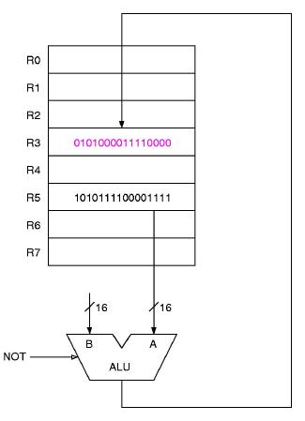
NOT data path
NOT R3, R5

Slide 12
ADD: Two's complement 16-bit Addition
Assembler Instruction
ADD DR, SR1, SR2 ; DR = SR1 + SR2 (register addressing)
ADD DR, SR1, imm5 ; DR = SR1 + Sext(imm5) (immediate addressing)
Encoding
0001 DR SR1 0 00 SR2
0001 DR SR1 1 imm5
Examples
ADD R1, R4, R5
ADD R1, R4, # -2
  Note: Condition codes are set

Slide 13
AND: Bitwise Logical AND
Assembler Instruction
AND DR, SR1, SR2 ; DR = SR1 AND SR2
AND DR, SR1, imm5 ; DR = SR1 AND Sext(imm5)
Encoding
0101 DR SR1 0 00 SR2
0101 DR SR1 1 imm5
Examples
AND R2, R3, R6
AND R2, R2, #0 ; Clear R2 to 0
Question: if the immediate value is only 6 bits, how can it mask the whole of R2?
  Note: Condition codes are set.

Slide 14
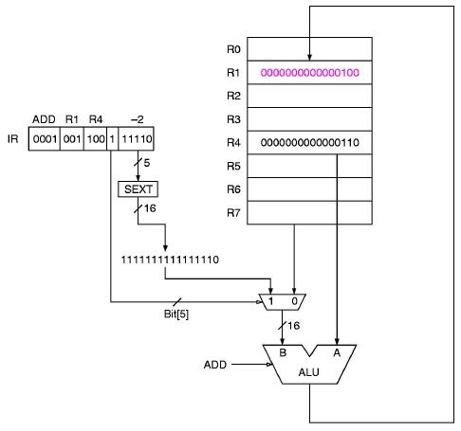
ADD data path
ADD R1, R4, # -2

Slide 15
Data Movement Instructions - 1
Move Data
  from register to memory => store
    nominated register is Source
  from memory to register => load
    nominated register is Destination
  The LC-3 cannot move data from memory to memory
  also to/from I/O devices (later)
LC-3 Load/Store Instructions
  LD, LDI, LDR, LEA, ST, STI, STR
  Format:
15 14 13 12 11 10 9 8 7 6 5 4 3 2 1 0
opcode
DR or SR
Address generator bits

Slide 16
Data Movement Instructions - 2
LC-3 Load/Store Addressing modes:
    immediate: LEA
      No Effective Address (EA) calculation; the Sign Extended Addr. Generator is added to the current value of the Program Counter - i.e.
      DR <= (PC) + SEXT( IR[8:0] )
    direct or PC-Relative: LD & ST
      The EA is the Sign Extended Addr. Generator added to the current value of the Program Counter - i.e.
      EA = (PC) + SEXT( IR[8:0] )
      DR <= Mem[ (PC) + SEXT( IR[8:0] ) ]
    indirect: LDI & SDI
      EA = Mem[ (PC) + SEXT( IR[8:0] ) ]
      DR <= Mem[Mem[ (PC) + SEXT( IR[8:0] ) ] ]
    base+offset: LDR & STR (BaseReg is specified by IR[8:6])
      EA = BaseReg + SEXT( IR[5:0] )
      DR <= Mem[ BaseReg + SEXT( IR[5:0] ) ]

Slide 17
Memory Addressing Modes
Direct addressing (PC-Relative)
  effective address = (PC) + SEXT( IR[8:0] )
  operand location must be within approx. 256 locations
  of the instruction
    actually between +256 and -255 locations of the instruction
    being executed (why?)
[15:12]
[11:9]
[8:0]
LD
DR
Addr. Gen. bits

Slide 18
Memory Addressing Modes - 2
Indirect addressing
  Same initial mechanism as direct mode (i.e. PC-Relative), but the calculated memory location now contains the address of the operand, (i.e. the ea is indirect):
  pointer address = (PC) + SEXT( IR[8:0] )
  effective address = Mem[ (PC) + SEXT( IR[8:0] ) ]
    Note that the memory has to be accessed twice to get the actual operand.
[15:12]
[11:9]
[8:0]
LDI
DR
Addr. Gen. bits

Slide 19
Memory Addressing Modes - 3
Relative (Base+Offset) addressing
  effective address = (BaseRegister) + offset
    sign extend (SEXT) the 6 bit offset ([5:0]) to 16 bits
    add it to the contents of the Base Register ([8:6])
  differences from Direct addressing (PC-Relative):
    base+offset field is 6 bits, PC-Relative offset field is 9 bits
    base+offset can address any location in memory, PC-Relative
    offset only within +/- 256 locations of the instruction.
[15:12]
[11:9]
[8:6]
[5:0]
LDR
DR
BaseR
offset

Slide 20
LD: Load Direct
Assembler Inst.
LD DR, LABEL ; DR <= Mem[LABEL]
Encoding
0010 DR PCoffset9
Examples
LD R2, param ; R2 <= Mem[param]
  Notes: The LABEL must be within +256/-255 lines of the instruction.
  Condition codes are set.

Slide 21
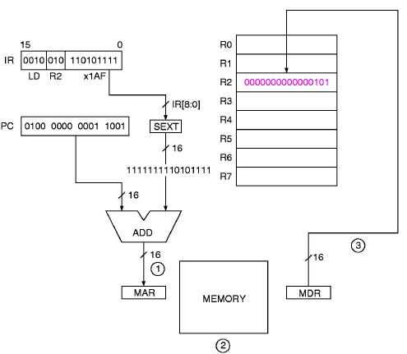
LD data path
LD R2, x1AF

Slide 22
LDI: Load Indirect
Assembler Inst.
LDI DR, LABEL ; DR <= Mem[Mem[LABEL]]
Encoding
1010 DR PCoffset9
Examples
LDI R2, POINTER ; R2 <= Mem[Mem[POINTER]]
  Notes: The LABEL must be within +256/-255 lines of the instruction.
  Condition codes are set.

Slide 23
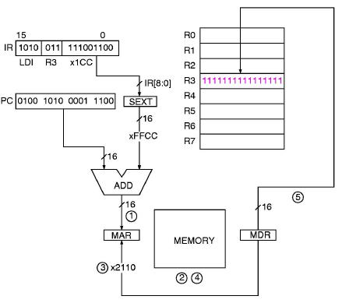
LDI data path
LDI R3, x1CC

Slide 24
LDR: Load Base+Index
Assembler Inst.
LDR DR, BaseR, offset ; DR <= Mem[ BaseR+SEXT( IR[5:0] )]
Encoding
0110 DR BaseR offset6
Examples
LD R2, R3, #15 ; R2 <= Mem[(R3)+15]
  Notes: The 6 bit offset is a 2’s complement number, so range is -32 to +31.
  Condition codes are set.

Slide 25
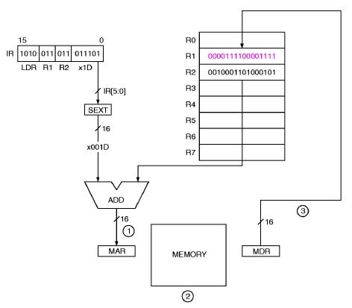
LDR data path
LDR R1, R2, x1D

Slide 26
LEA: Load Effective Address
Assembler Inst.
LEA DR, LABEL ; DR <= LABEL
Encoding
1110 DR offset9 (i.e. address of LABEL = (PC) + SEXT(offset9)
Examples
LEA R2, DATA ; R2 gets the address of DATA
  Notes: The LABEL must be within +/- 256 lines of the instruction.
  Condition codes are set.

Slide 27
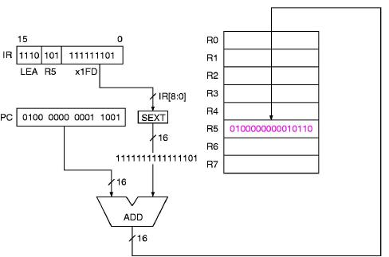
LEA data path
LEA R5, # -3

Slide 28
ST: Store Direct
Assembler Inst.
ST SR, LABEL ; Mem[LABEL] <= SR
Encoding
0011 SR offset9
Examples
ST R2, VALUE ; Mem[VALUE] <= R2
  Notes: The LABEL must within +/- 256 lines of the instruction.
  Condition codes are NOT set.

Slide 29
STI: Store Indirect
Assembler Inst.
STI SR, LABEL ; Mem[Mem[LABEL]] <= SR
Encoding
0011 SR offset9
Examples
STI R2, POINTER ; Mem[Mem[POINTER]] <= R2
  Notes: The LABEL must be within +/- 256 lines of the instruction.
  Condition codes are NOT set.

Slide 30
STR: Store Base+Index
Assembler Inst.
STR SR, BaseR, offset6 ; Mem[BaseR+SEXT(offset6)] <= (SR)
Encoding
0111 SR BaseR offset6
Examples
STR R2, R4, #15 ; Mem[R4+15] <= (R2)
  Notes: The offset is sign-extended to 16 bits.
  Condition codes are not set.

Slide 31
Addressing Examples
What is the EA for the following instructions?
Given:
PC = x2081, R6 = x2035, LOC = x2044, Mem[x2044] = x3456
  LDI R2, LOC
  Encoding:
  1010 010 1 1100 0011
  Indirect addressing:
  EA = Mem[x2044] = x3456
  LDR R1, R6, #12
  Encoding:
  0110 001 110 00 1100
  Base+Offset addressing:
  EA = (R6)+12 = x2035 + x000C
  = x2041
  ADD R1, R3, R2
  Register addressing:
  DR = R1, SR1 = R3, SR2 = R2
  DR <= ?
  ADD R5, R1, #15
  Immediate addressing:
  DR = R5, SR1 = R1, S2 = 15
  DR <= ?
  LD R1, LOC
  Direct addressing:
  DR <= ?

Slide 32
Control Instructions
Change the Program Counter
  Conditionally or unconditionally
  Store the original PC (subroutine calls) or not (go-to)
LC-3 Control Instructions
  BRx, JMP/RET, JSR/JSRR, TRAP, RTI
    BRx uses PC-Relative addressing with 9-bit offset
    JSR uses PC-Relative addressing with 11-bit offset
    JMP/RET & JSRR use base+offset addressing with zero offset
    we’ll deal with TRAP & RTI later

Slide 33
BR: Conditional Branch
Assembler Inst.
BRx LABEL
where x = n, z, p, nz, np, zp, or nzp
  Branch to LABEL iff the selected condition code are set
Encoding
0000 n z p PCoffset9
Examples
BRzp LOOP ; branch to LOOP if previous op returned zero or positive.

Slide 34
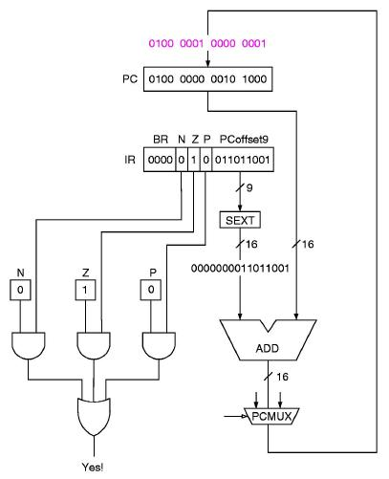
BR data path
BRz x0D9

Slide 35
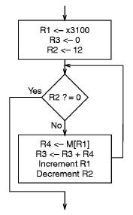
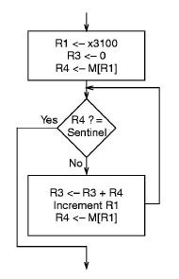
Building loops using BR
Counter control
Sentinel control

Slide 36
JMP: Jump or Go To
Assembler Inst.
JMP BaseR
  Take the next instruction from the address stored in BaseR
Encoding
1100 000 BaseR 00 0000
Example
JMP R5 ; if (R5) = x3500, the address x3500 is written to the PC

Slide 37
TRAP Instruction
  Used to invoke an operating system service.
  Trap vector table: a list of locations of the service call routines.
  TRAP has one operand, the trap vector:
  PC is set to the value stored at that location of the vector table.
  Some special trap vectors:
  * x20: input a character from the keyboard
  * x23: input a character from the keyboard, with prompt & echo
  * x21: output a character to the console display
  * x25: halt the program
  More details later

Slide 38
TRAP: Invoke a system routine
Assembler Inst.
TRAP trapvec
Encoding
1111 0000 trapvect8
Examples
TRAP x23
  Note: R7 <= (PC) (for eventual return)
  PC <= Mem[Zext(trapvect8)]

Slide 39
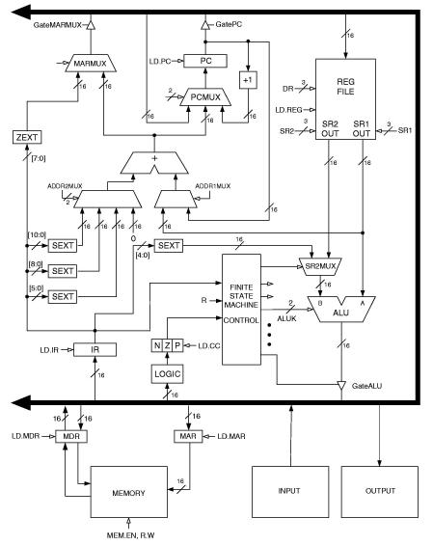
Data Path - 1
  Global Bus
    16-bit, data & address
    connects all components
    is shared by all
  Memory
    Memory Address Register: MAR
      address of location to be accessed
    Memory Data Register: MDR
      data loaded or to be stored

Slide 40
Data Path - 2
  ALU & Registers
    Two ALU sources
      source 1: register
      source 2: register or IR
    Result: goes onto bus, then to DR
  PC & PCMUX
    PC sends address to MAR for instruction fetch
    PCMUX: a 3:1 mux that selects the new PC
      Incremented PC
      offset PC (9 or 11 bits)
      offset BaseR (6 bits or 0)
      TRAP vector contents

Slide 41
Data Path - 3
  MARMUX
    A 2:1 mux that selects the source of MAR
      PC-Relative addressing
      BaseR + offset addressing
      Trap vector

